Slide 1


Beni-Suef National University
Faculty of Computers and Artificial Intelligence
CadArena
Integrating LLMs for an Enhanced Engineering Design Workflow
Supervisor: Dr. Amira Mohey El Din Mohamed
Presented by:
Youssef Taha • Maher Ibrahim • Omnia Ayman • Samar Nashaat
Academic Year: 2025 / 2026
1
Notes:
1

Slide 2

OUR TEAM
Meet the Team
Youssef Taha Mohamed Badawi
Maher Ibrahim El-Shahat
Backend and System Architect
RAG Developer
Omnia Ayman Abdel-Badi
Samar Nashaat
Frontend Developer
UI / UX Developer
Dr. Amira Mohey El Din Mohamed
Academic Supervisor
2
Notes:
2

Slide 3



OVERVIEW
Presentation Agenda
1
Introduction & Problem
6
DXF Engine
What CadArena is and why it was built
Converting layouts to professional CAD files
2
Why Not ML?
7
ArchChat & RAG
The challenges we faced before choosing our approach
Intelligent engineering knowledge assistant
3
LLM Experiments
8
Frontend & UI/UX
Zero-shot, few-shot, and why direct generation failed
Design Studio, Community, and user experience
4
System Architecture
8
Testing & Evaluation
How the platform is structured
Accuracy metrics and performance benchmarks
5
CadStudio Core
10
Conclusion & Q&A
AI-powered floor plan generation pipeline
Achievements and future directions
3
Notes:
3

Slide 4


INTRODUCTION
What is CadArena?
CadArena is an AI-powered architectural design platform that transforms natural language descriptions into professional 2D residential floor plans — validated against architectural rules and exported as DXF files compatible with AutoCAD and Revit.
🏗 NATURAL LANGUAGE → FLOOR PLAN
📋 ARCHITECTURAL VALIDATION
📐 DXF EXPORT
🤖 RAG KNOWLEDGE ASSISTANT
4
Notes:
4

Slide 5
HISTORY OF CAD
Evolution of CAD Technology
1963
Sketchpad
First interactive CAD system
1982
AutoDesk → AutoCAD
Desktop CAD goes mainstream
2000
Parametric CAD
SolidWorks and CATIA dominate
2020
AI-Assisted CAD
Machine learning enters design
2025
CadArena ★
LLM + RAG + real-time DXF generation
5
Notes:
5

Slide 6
THE PROBLEM
Why Traditional CAD Workflows Fall Short?
Architects still translate ideas into drawings manually — this is slow, error-prone, and inaccessible.
1
Manual and Time-Intensive
Even simple floor plans require considerable manual time and repeated adjustments.
2
No Natural Language Interface
CAD tools require specialized commands, not plain descriptions.
3
Iterative Revisions are Costly
Each change requires manual re-drafting from scratch.
4
Validation is Separate
Compliance with design rules is checked after the design is done, not during.
5
No Integrated Knowledge Assistance
Engineers must switch between CAD tools and external references constantly.
6
Notes:
6

Slide 7
OUR JOURNEY
How We Approached the Problem?
Define the Problem
Face Real Challenges
Identify pain points in architectural CAD workflows
Data scarcity, DXF complexity, labeling costs
1
2
3
4
Explore Solutions
Build CadArena
Evaluate Machine Learning, rule-based systems, and LLMs
LLM + RAG + rule-based DXF engine — the right combination
7
Notes:
7

Slide 8
OUR JOURNEY — APPROACH SELECTION
Why We Did Not Use Pure Machine Learning?
1
No Labeled Dataset Available
Pure ML Requires:
No existing dataset of (prompt → validated floor plan) pairs for Arabic/Egyptian residential architecture exists. Creating one would require hundreds of expert architect hours.
  ✗ Thousands of labeled examples
  ✗ Domain-expert annotators
  ✗ Months of GPU training time
  ✗ Expensive infrastructure
2
DXF Files Are Structurally Complex
→ We chose a Hybrid Architecture:
LLM for language understanding
+
Deterministic engine for geometry
DXF documents contain strict hierarchical entity structures, coordinate systems, and layer organization. Sequence models cannot guarantee geometrically valid outputs without massive domain-specific training data.
3
High Labeling Cost
Annotating architectural drawings with room types, dimensions, adjacency rules, and building code compliance requires specialized expertise — not feasible at the scale needed for supervised ML.
8
Notes:
8

Slide 9

OUR JOURNEY — LLM EXPERIMENTS
What Happened When We Tried Direct LLM Generation?
We tested both frontier and open-source models with the same architectural prompt before finalizing our architecture.
Create a DXF floor plan following the Egyptian Building Code (EBC) for a 12m × 24m residential building with two bedrooms, one kitchen, one bathroom, and a central corridor.
Model
Strategy
DXF Valid?
Geometry Correct?
EBC Compliant?
Verdict
ChatGPT (GPT-4)
Zero-shot
Partial
Poor
✗ No
✗ Rejected
ChatGPT (GPT-4)
Few-shot
Better
Inconsistent
✗ No
✗ Unreliable
Google Gemini
Zero-shot
Partial
Poor
✗ No
✗ Rejected
Google Gemini
Few-shot
Better
Inconsistent
✗ No
✗ Unreliable
LLaMA 3 (local)
Zero-shot
Rare
Very Poor
✗ No
✗ Failed
Mistral 7B (local)
Few-shot
Occasional
Poor
✗ No
✗ Failed
CadArena (Hybrid)
LLM + Rules
Always ✓
Correct ✓
✓ Yes
✓ Adopted
9
Notes:
9

Slide 10
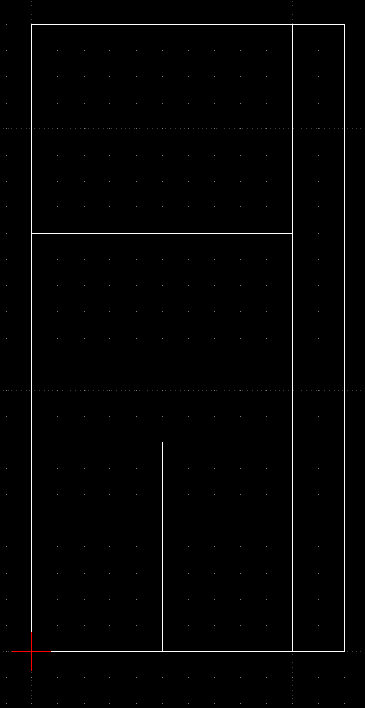
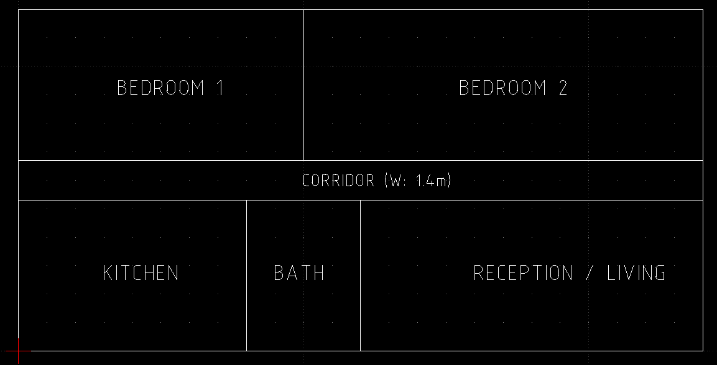

Slide 11

OUR JOURNEY — FAILURE ANALYSIS
Specific Failures in Direct LLM-Based Design Generation
1
Hallucinated Coordinates
Models generated geometrically impossible room positions — rooms overlapping, walls misaligned, coordinates outside the building boundary.
Our Solution: Hybrid Architecture
2
Invalid DXF Structure
Output frequently broke DXF file format standards — missing section headers, incorrect entity ordering, or corrupt layer definitions that CAD software could not open.
LLM handles ONLY:
→ Natural language understanding
→ Parameter extraction
Deterministic engine handles:
→ Layout geometry generation
→ Architectural rule enforcement
→ EBC 2023 validation
→ DXF rendering
3
No EBC Knowledge
Models had zero built-in knowledge of the Egyptian Building Code (EBC 2023) minimum room areas, corridor widths, or forbidden adjacencies.
4
Non-Deterministic Output
Result: 100% structurally valid DXF output
The same prompt produced different — sometimes completely incompatible — layouts on repeated runs due to the stochastic nature of LLMs.
10
Notes:
10

Slide 12
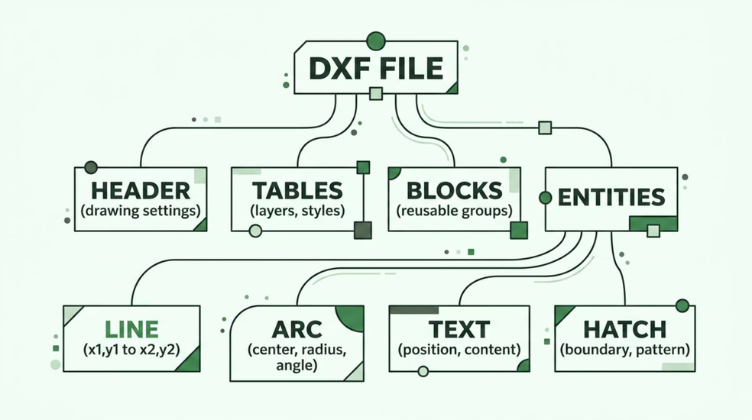
TECHNICAL BACKGROUND
What is a DXF File?
DXF (Drawing Exchange Format) is the universal interchange format for CAD data, created by Autodesk in 1982. It stores technical drawings as structured text — listing every geometric entity (lines, arcs, circles, text) with its exact coordinates, layer, and properties.
DXF files are readable by AutoCAD, Revit, LibreCAD, FreeCAD, and virtually every professional CAD application.
OPEN STANDARD
AUTOCAD COMPATIBLE
USED IN CADARENA
11
Notes:
11

Slide 13


TECHNICAL BACKGROUND
Why DXF Generation is Challenging for AI?
1
2
3
Strict Syntax Rules
Geometric Precision
Complex Relationships
A single malformed entity invalidates the entire file. No partial credit — either fully valid or completely broken.
Coordinates must be numerically exact. A wall that is 0.5mm off will create overlapping rooms or gaps in the floor plan.
Rooms must connect correctly. Doors must align to walls. Dimensions must reference real geometry. LLMs cannot enforce these constraints alone.
CadArena separates concerns: LLM understands language → rules engine generates geometry → validator checks DXF integrity
12
Notes:
12

Slide 14

COMPARATIVE ANALYSIS
CadArena vs. Existing Systems
System
LLM Integration
DXF Output
EBC Validation
Local Deploy
Limitation
Real-Time
AutoCAD AI
Partial (plugin)
Partial
No
No
No
Requires license + cloud
ChatCAD
Cloud LLM
Limited
Partial
No
No
Limited DXF, no validation
DeepCAD
Partial
No
No
No
Partial
Geometry only, no NL interface
Text2CAD
Cloud LLM
Basic
No
No
No
Batch only, no refinement
SketchGen
Cloud LLM
SVG only
Yes
No
No
Not engineering-grade
Rayon
Cloud LLM
DXF supported
Yes
No
No
No EBC, cloud-only
CadArena
Integrated + RAG
Comprehensive ✓
Yes (EBC 2023) ✓
Yes (Docker) ✓
Yes (WebSocket) ✓
2D residential scope
13
Notes:
13

Slide 15
LITERATURE REVIEW
The Research Gap We Fill
What Was Missing
What CadArena Delivers
1
No End-to-End NL → DXF in real time
1
Prompt → DXF in Under 5 Seconds
No system converts natural language to DXF in real-time.
Real-time natural language to DXF conversion.
2
No iterative prompt-based refinement
Existing tools don't allow prompt-based design iteration.
2
Full iterative chat-based refinement
Design modifications seamlessly via chat interface.
3
No automatic EBC 2023 validation
Building code checks are entirely manual, error-prone, and slow.
3
Automatic EBC 2023 Validation
Built-in, instant compliance checks against local codes.
4
No Arabic language CAD platform
4
Bilingual Support
There is no CAD solution supporting the Arabic language.
Comprehensive support for both Arabic and English input.
5
No open-source local LLM CAD tool
5
Local deployment — no cloud dependency
14
Notes:
14

Slide 16
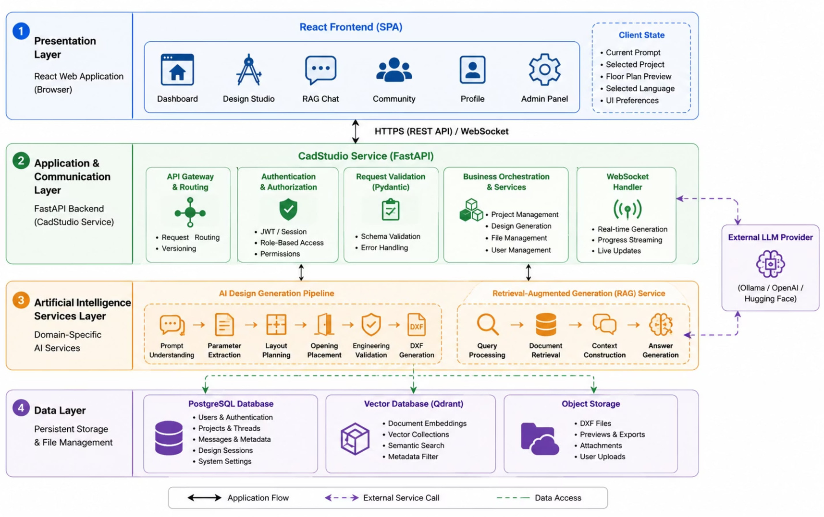
SYSTEM DESIGN
CadArena — High-Level System Architecture
15
Notes:
15

Slide 17
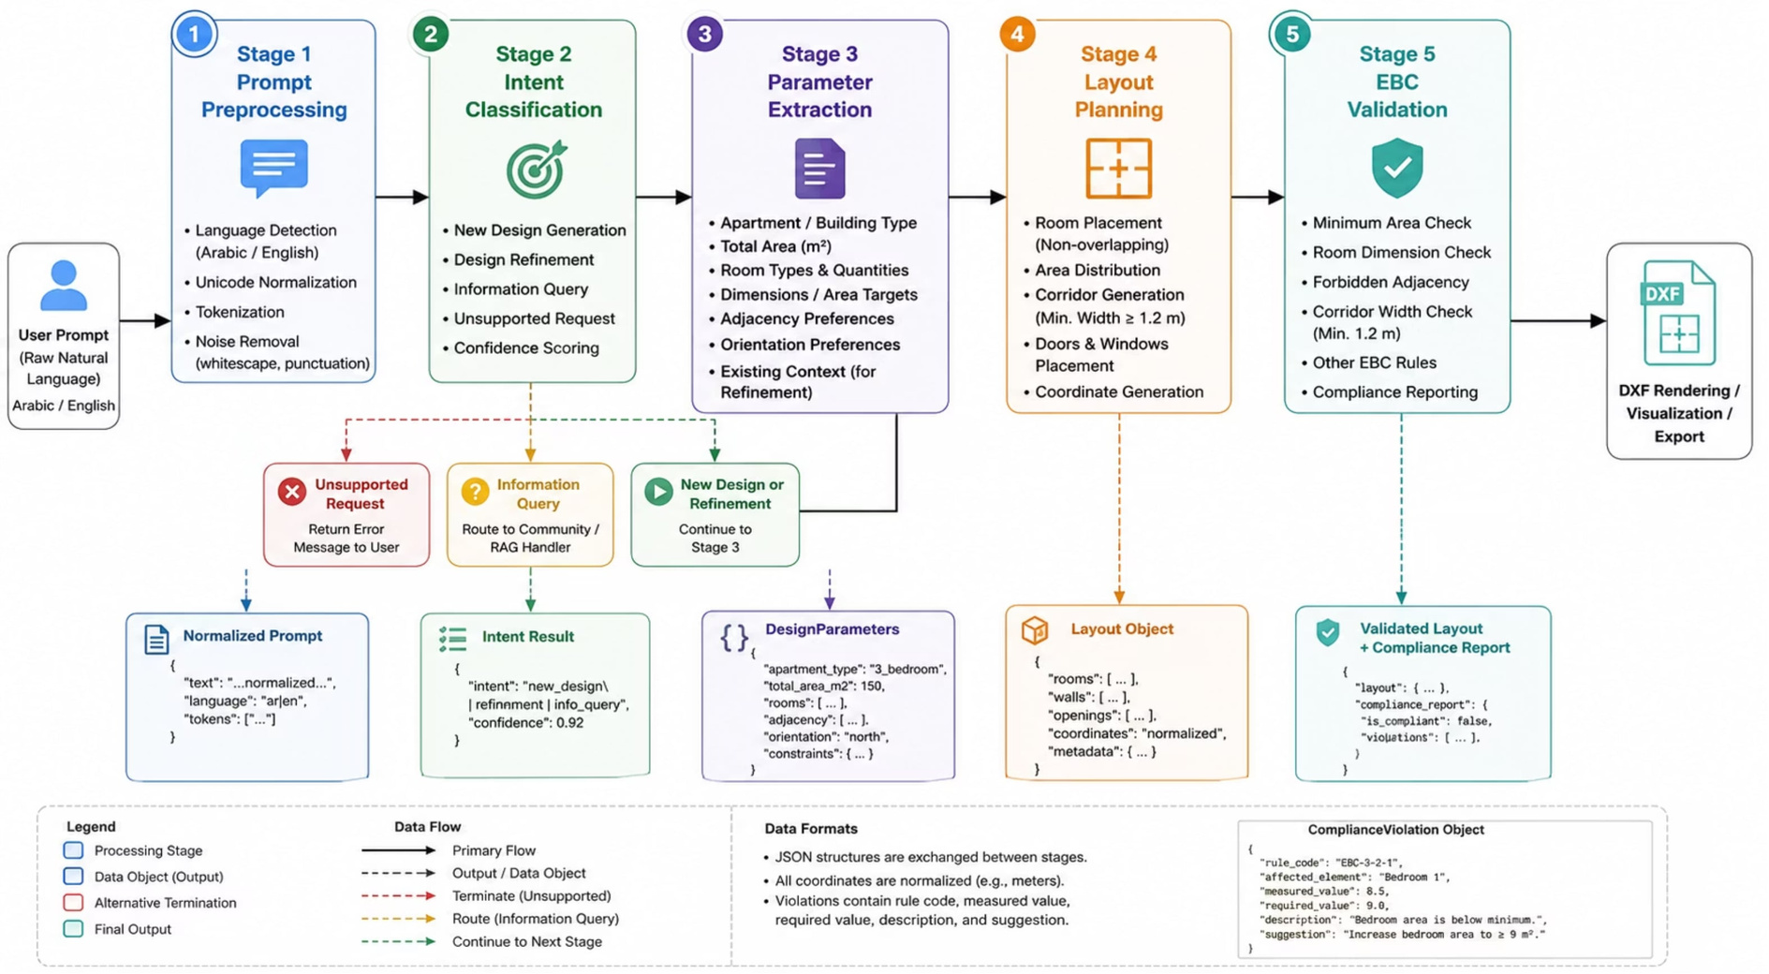
CADSTUDIO — NLP PIPELINE
5-Stage NLP Pipeline: From Text to Floor Plan
16
Notes:
16

Slide 18



CADSTUDIO — PIPELINE DEEP DIVE
Stage 1: Preprocessing + Stage 2: Intent Classification
Prompt Preprocessing
Intent Classification — Two-Stage Strategy
Input: Raw user text (Arabic or English)
Operations performed:
First: Lightweight rule-based classifier using keyword patterns
If low confidence → LLM-based semantic classifier
Four intent classes:
  Language detection (Arabic / English)
  Unicode normalization for Arabic characters
  Text cleaning and whitespace normalization
  Tokenization for downstream analysis
  New Design Generation
  Design Refinement
  Information Query
  Unsupported Request
Output: Normalized prompt + detected language
Output: Intent label + confidence score
If Unsupported → pipeline terminates gracefully | If Query → routed to RAG | If Design → continues to Stage 3
17
Notes:
17

Slide 19


CADSTUDIO — PIPELINE DEEP DIVE
Stage 3: Parameter Extraction + Stage 4: Layout Planning
Parameter Extraction (via LLM)
Layout Planning (Deterministic Algorithm)
LLM extracts structured DesignParameters JSON:
Rule-based spatial planning — NOT the LLM:
  Apartment type (studio / 1BR / 2BR / 3BR / villa)
  Total target area (m²)
  Room types and quantities
  Room dimension constraints
  Adjacency preferences
  Orientation requirements
  Primary spaces placed first (living room, master bedroom)
  Secondary spaces allocated in remaining area
  Service spaces (bathrooms, corridors) positioned last
  Door/window positions calculated from adjacency rules
  Non-overlapping placement enforced throughout
For refinements: current session context is loaded first
Output: Structured DesignParameters object
Output: Normalized LayoutObject with room geometries, wall segments, openings
18
Notes:
18

Slide 20

CADSTUDIO — EBC 2023 VALIDATION
Stage 5: Egyptian Building Code Compliance Validation
Validation Rules & Minimums
ComplianceViolation Object
Rule Checked
Minimum Value
Returned for each detected violation:
Bedroom area
9.0 m²
  rule_identifier
  affected_element
  measured_value
  required_value
  violation_description
  recommended_corrective_action
Bathroom area
2.5 m²
Kitchen area
4.0 m²
Living room area
12.0 m²
Corridor width
1.2 m (hard limit)
Room overlap
Zero tolerance
Boundary coverage
100% inside perimeter
Forbidden Adjacencies Detected:
  ✗ Bathroom ↔ Kitchen
  ✗ Bedroom ↔ Kitchen
  ✗ Bathroom ↔ Dining Room
✓ Every layout is validated BEFORE DXF generation — violations are reported to the user immediately
EBC-01 through EBC-10 — all ✓ Pass
19
Notes:
19

Slide 21
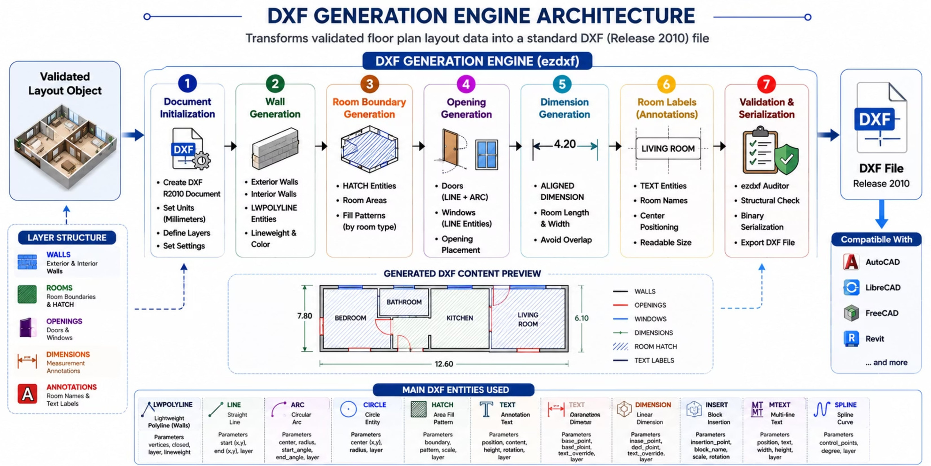
CADSTUDIO — DXF ENGINE
DXF Generation Engine — From Layout to CAD File
20
Notes:
20

Slide 22

CADSTUDIO — DXF ENGINE
1
Document Initialization
2
Wall Generation
DXF Layer Organization
Sets up DXF header, layers, and basic drawing properties.
Draws wall polylines based on calculated room geometries.
Layer
Color
Contains
WALLS
White/Black
Structural wall polylines
3
Room Representation
4
Opening Generation
Generates room boundaries and applies appropriate hatching patterns.
Inserts doors (arcs) and windows (lines) into wall segments.
ROOMS
Green
Hatch room boundaries
OPENINGS
Blue
Door arcs and window lines
5
Dimension Annotations
6
Room Labels
DIMENSIONS
Yellow
Room measurement annotations
Adds linear dimensions for room sizes and wall lengths.
Places text entities for room names and functional areas.
7
Validation & Export
ANNOTATIONS
Cyan
Room name text labels
Performs final DXF structure check and saves the file.
EZDXF PYTHON LIBRARY — DXF RELEASE 2010 STANDARD
COMPATIBLE: AUTOCAD · LIBRECAD · FREECAD · REVIT
21
Notes:
21

Slide 23
CADSTUDIO — DXF ENGINE
DXF Entities Supported by the Rendering Engine
DXF Entity
Description
Key Parameters
LINE
Straight wall segment
start/end (x,y), layer, color
CIRCLE
Full circular feature
center (x,y), radius, layer
ARC
Door swing path
center, radius, start/end angle, layer
RECTANGLE
Closed room boundary
origin (x,y), width, height, layer
LWPOLYLINE
Multi-vertex wall or polygon
vertices list, closed, layer
TEXT
Room name annotation
position (x,y), content, height, layer
MTEXT
Multi-line formatted text
insertion point, content, width, layer
DIMENSION
Linear measurement mark
base point, def point, layer
HATCH
Area fill pattern
boundary, pattern name, scale, layer
20+ entity types supported in total — only relevant entities instantiated per design
22
Notes:
22

Slide 24
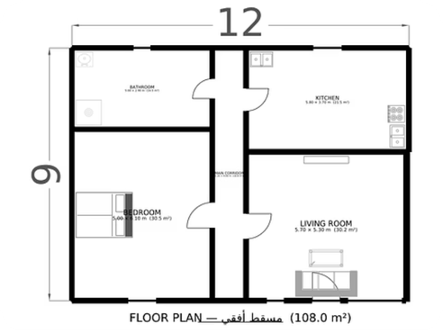
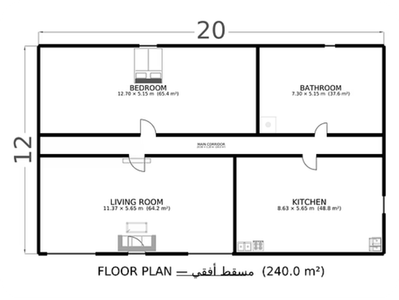
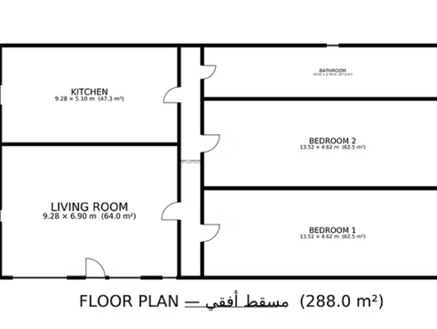
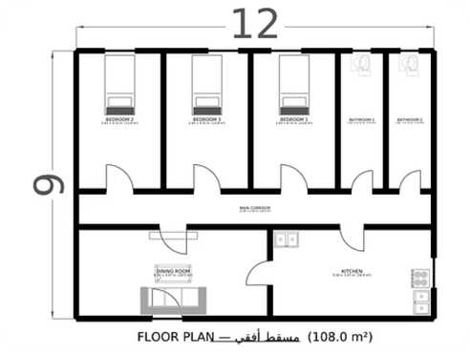
CADSTUDIO — SAMPLE OUTPUT
Sample Generated Floor Plans
Studio Apartment
Generated Area: 108 m²
One-Bedroom Apartment
Generated Area: 240 m²
Two-Bedroom Apartment
Generated Area: 288 m²
Three-Bedroom Apartment
Generated Area: 108 m²
ALL OUTPUTS: EZDXF-VALIDATED · AUTOCAD-COMPATIBLE · DXF RELEASE 2010
23
Notes:
23

Slide 25
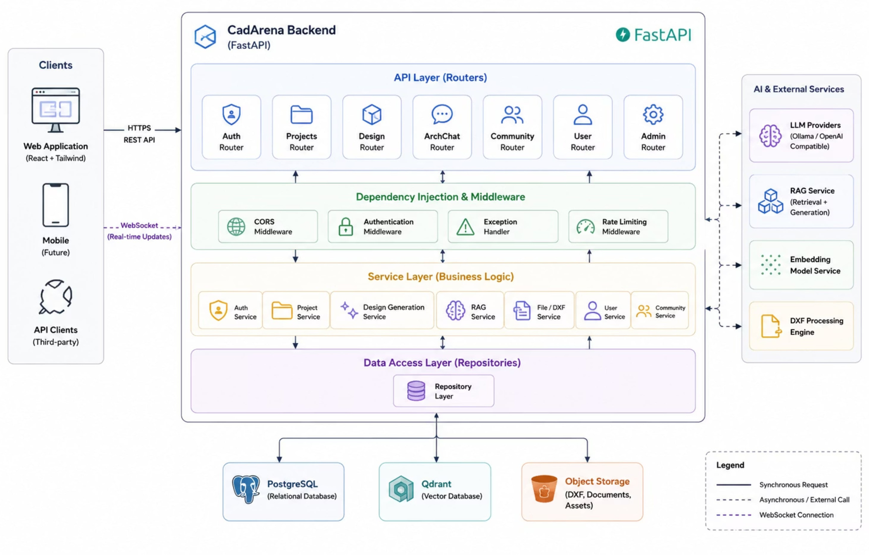
BACKEND
FastAPI Backend Implementation
24
Notes:
24

Slide 26
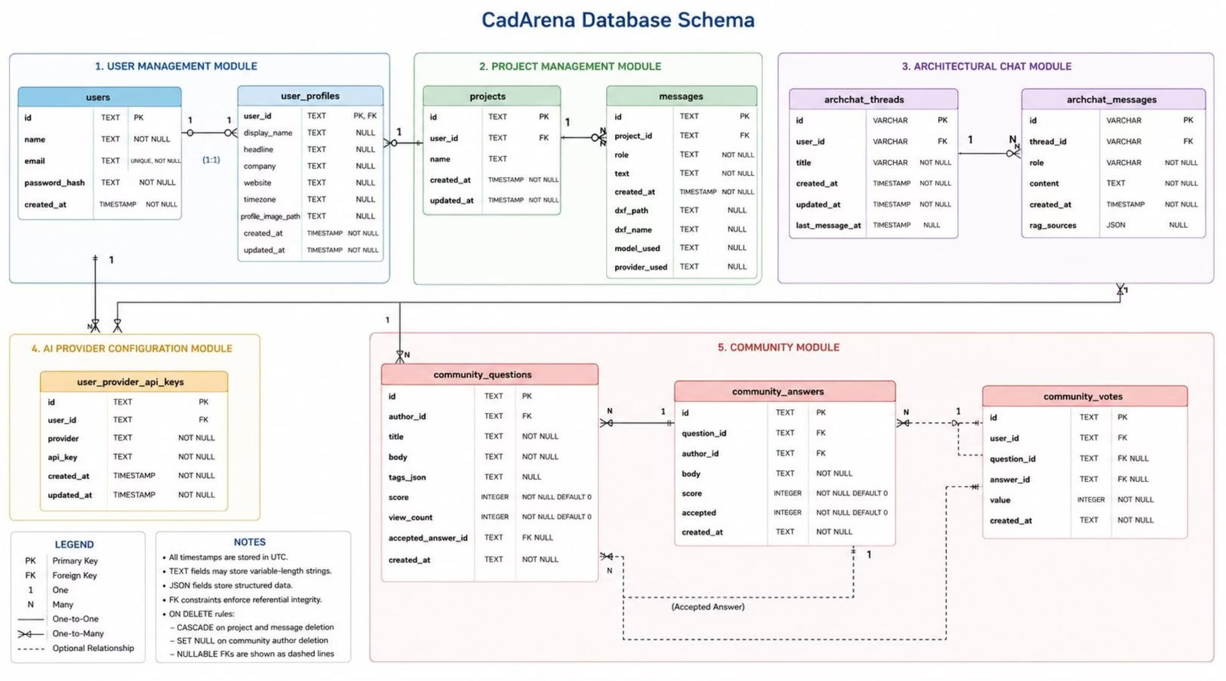
DATABASE
Database Schema
25
Notes:
25

Slide 27



PRESENTER TRANSITION
ArchChat — AI-Powered Engineering Knowledge Assistant
Next
Maher will present ArchChat — our Retrieval-Augmented Generation service for engineering knowledge assistance.
What is RAG and why we use it?
How ArchChat is architected (layer by layer)?
Live knowledge retrieval from engineering documents
From design generation to knowledge intelligence →
26
Notes:
26

Slide 28
ARCHCHAT — MOTIVATION
Why Retrieval-Augmented Generation?
Without RAG (Direct LLM)
With RAG (ArchChat)
  Answers based solely on training data — may be outdated or incorrect
  No access to project-specific documents
  Cannot reference Egyptian Building Code specifics
  Hallucinations in technical domain answers
  No citations — user cannot verify the source
  Answers grounded in retrieved engineering documents
  Supports user-uploaded project documentation
  Can cite specific EBC 2023 rules with references
  Reduces hallucinations through retrieval grounding
  Every response includes source citations
RAG = RETRIEVAL-AUGMENTED GENERATION: THE LLM ANSWERS USING RETRIEVED DOCUMENTS, NOT JUST FROM MEMORY
27
Notes:
27

Slide 29

ARCHCHAT — ARCHITECTURE
ArchChat — Retrieval-Augmented Generation Architecture
User Query
Vector Search
Embedding Model
Top-K Context
Qdrant Vector Database
Knowledge Sources
  Stores dense vector embeddings of document chunks
  Semantic similarity search at query time
  Supports project-specific and global knowledge bases
  User-uploaded engineering documents
  Egyptian Building Code (EBC 2023) references
  Architectural design standards and guidelines
  Project conversation history for context
⚠ ArchChat is a completely separate service from the CadStudio design pipeline — independent FastAPI service, independent Qdrant instance
28
Notes:
28

Slide 30





ARCHCHAT — DEEP DIVE
ArchChat — Five Processing Layers
1. Document Ingestion Layer
User uploads engineering PDFs, CSV, standards, or project documents. These are chunked into segments, processed by the embedding model, and then stored in Qdrant for efficient retrieval.
2. Embedding Layer (embed-multilingual-v3.0)
A Sentence Transformer model converts raw text chunks into dense semantic vectors. This captures the true meaning and context of the content, moving beyond simple keyword matching.
3. Vector Store Layer
Qdrant, our high-performance vector database, efficiently stores and indexes all generated embeddings. This enables millisecond-level semantic similarity searches across thousands of document chunks.
4. Retrieval Layer
The user's query is also embedded, and the top-K most semantically relevant document chunks are retrieved from Qdrant. These chunks are then combined to form a rich context window for the LLM.
5. Generation Layer
The retrieved context, along with the original user question, is fed into a structured LLM prompt. Our local Ollama model then generates a coherent response, complete with source citations, ensuring transparency and verifiability.
29
Notes:
29

Slide 31

ARCHCHAT — DATABASE
ArchChat Database Structure
archchat_threads
archchat_messages
Description
Column
Column
Type
Type
Description
id
VARCHAR
Thread identifier (PK)
id
VARCHAR
Message identifier (PK)
thread_id
VARCHAR
FK → archchat_threads
user_id
VARCHAR
FK → users.id
role
VARCHAR
"user" or "assistant"
title
VARCHAR
Conversation title
content
TEXT
Message body
created_at
TIMESTAMP
Created
created_at
TIMESTAMP
Sent time
updated_at
TIMESTAMP
Last updated
rag_sources
JSON
Retrieved source citations
last_message_at
TIMESTAMP
Latest activity
Each assistant message stores the RAG sources used — full traceability from answer to document
30
Notes:
30

Slide 32
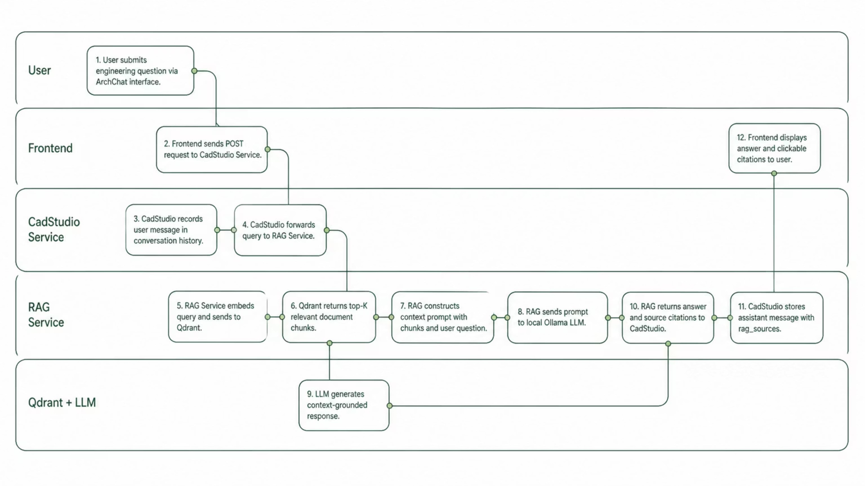
ARCHCHAT — WORKFLOW
How ArchChat Answers an Engineering Question
31
Notes:
31

Slide 33



PRESENTER TRANSITION
Frontend & User Interface — Part 1
Next
Samar will present the CadArena frontend — Landing Page, Design Studio, and AI Design Generation workflow.
The Landing Page and onboarding experience
The Design Studio workspace
The AI Design Generation workflow in the UI
From backend intelligence to user-facing experience →
32
Notes:
32

Slide 34

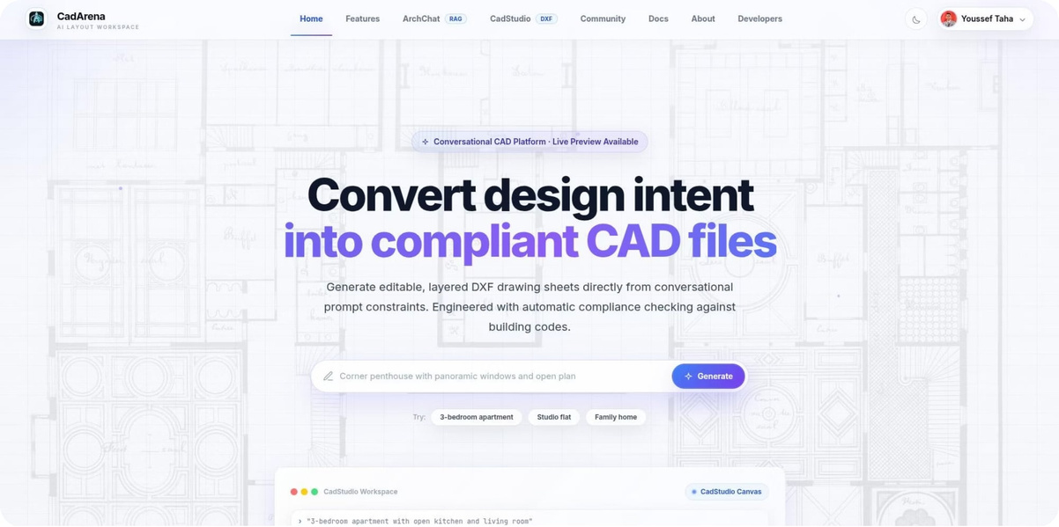




FRONTEND — LANDING PAGE
CadArena Landing Page
Direct access to CadStudio and ArchChat from navigation
Interactive prompt field — start generating immediately
Suggested prompt examples for new users
Professional engineering-oriented branding
Responsive design — desktop, tablet, mobile
Built with React 18 + Tailwind CSS + Framer Motion
33
Notes:
33

Slide 35
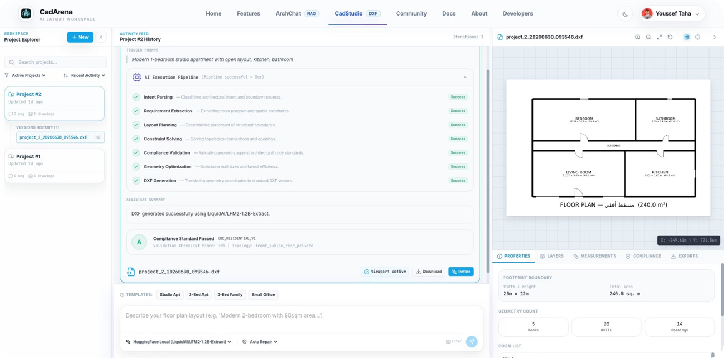
FRONTEND — DESIGN STUDIO
CadStudio — Design Studio Workspace
  Natural language prompt input (Arabic + English)
  Real-time DXF floor plan preview after generation
  AI model selector — choose Qwen, LLaMA, or Mistral
  Conversation history with previous design iterations
  One-click DXF download for CAD software
CadArena Design Studio with interactive prompt, real-time DXF preview, and essential controls.
34
Notes:
34

Slide 36
FRONTEND — GENERATION WORKFLOW
AI-Assisted Design Generation (Multi-Agent) — End to End
1. User Input
User enters specific design requirements, e.g., "Design a 3-bedroom apartment, 120m², master bedroom with en-suite, open kitchen".
2. Intent Classification
The system analyzes the prompt and classifies the user's core intent, for instance, `NEW_DESIGN_GENERATION`.
3. Parameter Extraction
Our LLM extracts key parameters like `
{type: "3-bedroom", area: 120, rooms: [...]}
` from the natural language input.
4. Layout Planning
The CadArena Layout Planner generates a geometrically valid and functional floor plan based on the extracted parameters.
5. EBC Compliance Validation
The EBC Validator confirms compliance: all rooms meet minimum dimensions, and no forbidden adjacencies exist.
6. DXF Rendering
The DXF Engine renders the plan, creating distinct layers for WALLS, ROOMS, OPENINGS, DIMENSIONS, and ANNOTATIONS.
7. Live Preview
The user immediately sees a real-time, interactive preview of the generated DXF floor plan in the Design Studio canvas.
8. DXF, PNG, PDF Download
With a single click, the user can download the AutoCAD-compatible DXF file for further editing or use.
35
Notes:
35

Slide 37
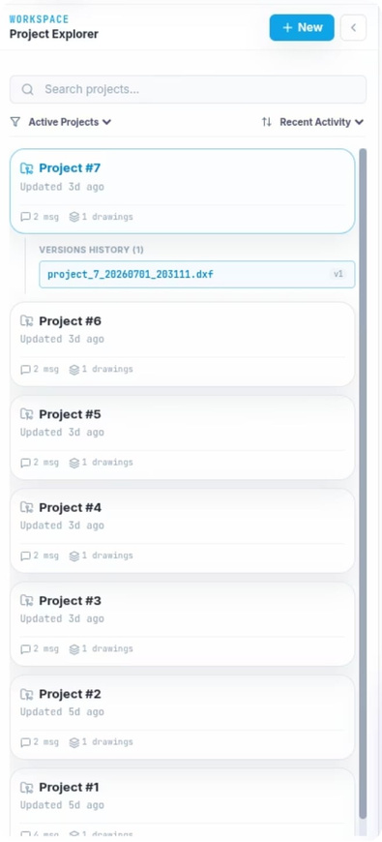
FRONTEND — PROJECT MANAGEMENT
Project Management — Organize Your Design Work
Create & Organize Projects
Create, rename, archive, and delete architectural design projects
Full Conversation History
Every prompt and generated design is saved per project — revisit any iteration
DXF File Linked to Prompt
Each generated DXF is tied to its exact prompt for full traceability
Resume Any Session
Open any previous project and continue from exactly where you left off
Secure Ownership
Each project belongs exclusively to one authenticated user
DATA MODEL: USERS → PROJECTS → MESSAGES (PROMPT_TEXT · DXF_PATH · MODEL_USED)
36
Notes:
36

Slide 38



PRESENTER TRANSITION
Frontend & User Interface — Part 2
Next
Omnia will present the remaining frontend — ArchChat interface, Community Hub, and the overall tech stack.
ArchChat UI — engineering knowledge interface
Community Hub — Q&A and collaboration
Technology stack and deployment
From design workspace to community knowledge →
37
Notes:
37

Slide 39
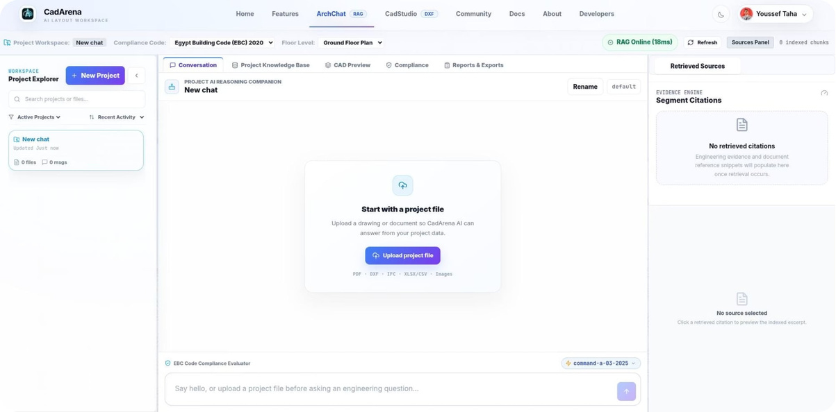
FRONTEND — ARCHCHAT
ArchChat — Engineering Knowledge Interface
  Conversational engineering assistant — ask questions in Arabic or English
  Upload project documents for project-specific knowledge retrieval
  Every answer includes clickable source citations
  Thread-based conversation history — revisit past questions
  Powered by Qdrant vector search + local Ollama LLM
38
Notes:
38

Slide 40
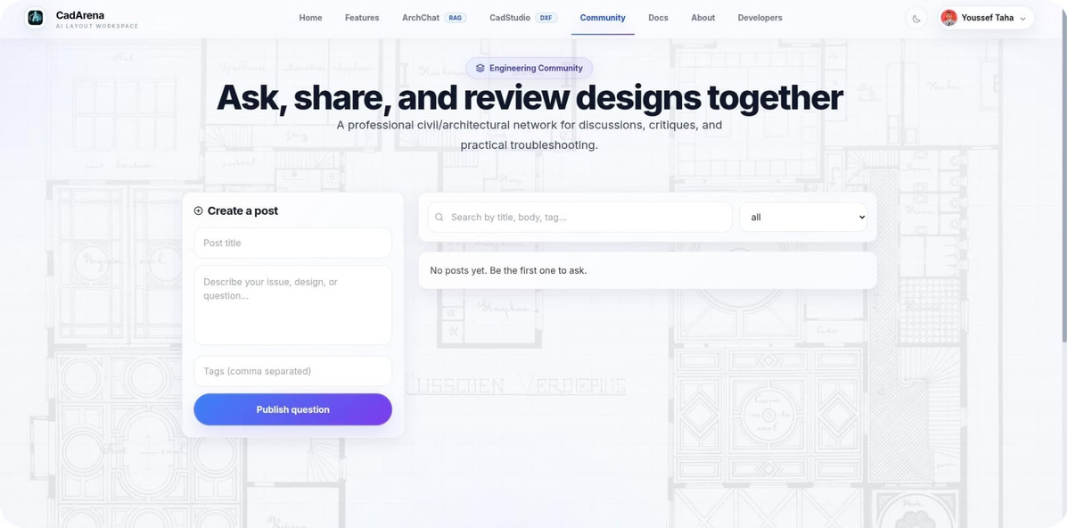
FRONTEND — COMMUNITY
Community Hub — Engineering Q&A
  Publish architectural questions — visible to all registered users
  Submit answers and replies from the community
  Upvote / downvote system — best answers rise to top
  Tag-based filtering for topic discovery
  Admin moderation for content quality
39
Notes:
39

Slide 41


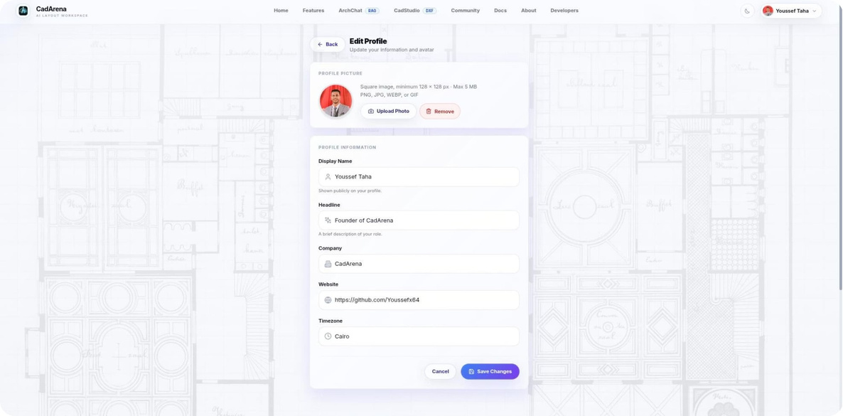



FRONTEND — USER PROFILE
User Profile and Settings
Profile Details
Update display name, professional headline, organization, and website.
AI Provider Configuration
Configure preferred AI provider and API keys with encrypted storage.
Avatar Management
Profile image upload and avatar customization.
Timezone Settings
Adjust timezone for accurate timestamp display.
Account Security
Manage password and authentication settings for secure access.
user_provider_api_keys table — encrypted API keys for each user's chosen LLM provider.
40
Notes:
40

Slide 42









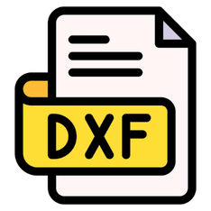


TECH STACK
Complete Technology Stack
React 18 + Tailwind CSS
Framer Motion + Lucide React
FastAPI (Python 3.12)
Ollama
LangChain
Qdrant
AI Runtime — Local LLM inference (Qwen Series, LLaMA 3, Mistral 7B)
RAG Pipeline — Document retrieval and prompt construction
Vector Database — Semantic document search
Frontend UI — Interactive SPA, responsive layouts
UI Layer — Animations, transitions, icons
Backend (MVC) — REST APIs, business logic, AI orchestration
Sentence Transformers
PostgreSQL
SQLAlchemy + Pydantic
ezdxf
JWT + OAuth 2.0
Docker + Docker Compose
Relational DB — Users, projects, messages, metadata
CAD Engine — DXF file generation (AutoCAD Release 2010)
Authentication — Secure user sessions and Google Sign-In
Embedding Model — Text-to-vector conversion
ORM + Validation — Schema management and data validation
Deployment — Containerized multi-service deployment
41
Notes:
41

Slide 43




PRESENTER TRANSITION
Testing, Evaluation & Conclusion
Returning
Youssef will present the final section —
Testing strategy, accuracy evaluation,
performance benchmarks, and conclusion.
Testing Strategy — Unit, Integration, System, Accuracy
Accuracy Metrics — DGSR, AFC, Validation Accuracy, DGT
Performance Benchmarks — latency, memory, concurrent users
Conclusion & Future Work — what we achieved and what comes next
From frontend experience to system validation →
42
Notes:
42

Slide 44
TESTING & EVALUATION
Testing Strategy
Unit Testing
Integration Testing
System Testing
Accuracy Evaluation
  Tool: pytest
  Scope: Individual backend services, parser modules, utility functions
  Goal: Verify correctness of individual software components
  Tool: Manual testing through the web interface
  Scope: Complete end-to-end user workflows
  Goal: Verify major user scenarios execute successfully
  Tool: FastAPI TestClient + Integration Test Suite
  Scope: API routes ↔ services ↔ database ↔ RAG subsystem communication
  Goal: Validate interactions between system components
  Tool: Custom evaluation metrics
  Scope: AI-generated architectural layouts
  Goal: Measure geometric correctness, completeness, dimensional accuracy, EBC compliance
43
Notes:
43

Slide 45
EVALUATION — AI ACCURACY
How We Measure CadArena's Accuracy?
1
2
3
Design Generation Success Rate (DGSR)
Architectural Feature Completeness (AFC)
Validation Accuracy (VA)
Formula: (Correctly Classified Violations / Total Violation Checks) × 100%
Measures how accurately the EBC validator detects and classifies violations.
Formula: (Successful Generations / Total Prompts) × 100%
A generation is successful if the complete pipeline executes and DXF renders without errors.
Formula: (Generated Features / Requested Features) × 100%
Measures whether all requested rooms and elements appear in the output.
4
5
Design Generation Time (DGT)
DXF Export Success Rate (DESR)
Total time from prompt submission to floor plan display in the Design Studio.
Reported as: Average / Minimum / Maximum across test cases.
Formula: (Successfully Exported DXF / Total Generated Layouts) × 100%
A success = file generated without errors AND opens correctly in CAD software.
44
Notes:
44

Slide 46

EVALUATION — RESULTS
Accuracy Evaluation — All Objectives Achieved
Metric
Evaluation Objective
Observed Result
Design Generation Success Rate
Generate complete layouts without runtime errors
✓ Successfully generated for all evaluated scenarios
Architectural Feature Completeness
Preserve all requested rooms and features
✓ All requested rooms correctly represented in outputs
Validation Accuracy
Correctly detect EBC constraint violations
✓ Validation module correctly identified valid and invalid designs
Design Generation Time
Provide interactive response time
✓ Generation completed within acceptable interactive time
DXF Export Success Rate
Produce downloadable CAD drawings
✓ All DXF files generated and opened correctly in CAD software
45
Notes:
45

Slide 47

EVALUATION — PERFORMANCE
Performance Benchmark Results
2.1s
13.8s
Stable
Fastest single-user generation
50 concurrent users
WebSocket 1-hour continuous session
Studio apartment
Stress test — marginal
Zero interruptions
Users
Avg Latency
CPU
Scenario
Peak Memory
Result
Single — Studio apartment
1
2.1s
1.8 GB
38%
✓ Pass
Single — Three-bedroom house
1
4.2s
2.3 GB
61%
✓ Pass
Single — Complex villa
1
6.8s
2.9 GB
78%
✓ Pass
Concurrent light load
10
5.1s
4.7 GB
72%
✓ Pass
Concurrent medium load
25
7.4s
9.2 GB
88%
✓ Pass
Concurrent stress test
50
13.8s
14.1 GB
96%
⚠ Marginal
50-user marginal: single Ollama GPU instance is the bottleneck — horizontal scaling resolves this.
46
Notes:
46

Slide 48
PROJECT JOURNEY
Development Timeline
Month 1–2
Month 4
Month 6
Research & Problem Definition
DXF Engine & EBC Validator
Frontend & Integration
Literature review, competitor analysis, architecture decisions
ezdxf integration, EBC 2023 rule implementation
React UI, WebSocket, Arabic localization, Docker
1
2
3
4
5
6
Month 3
Month 5
Month 7
Core Backend & NLP Pipeline
RAG Service
Testing & Evaluation
Embedding model, vector store, retrieval pipeline
FastAPI setup, intent router, parameter extraction
Unit tests, accuracy benchmark, performance testing
47
Notes:
47

Slide 49

FUTURE WORK
Future Directions
01
02
03
3D Architectural Modeling
Fine-tuned Domain LLM
Collaborative Multi-User Editing
Extend the DXF engine to 3D solid entities. Enable STEP/IFC export for full Building Information Modeling (BIM) workflows.
Train a specialized model on extensive Arabic/Egyptian architectural datasets. This will achieve higher accuracy in parameter extraction and intent classification.
Implement real-time shared Design Studio sessions. Allow multiple users to work on the same project simultaneously, enhancing team productivity.
04
05
06
Mobile Application
Expanded Building Codes
AutoCAD / Revit Plugin
Develop native iOS and Android applications. This will enable users to capture voice prompts and view DXF previews on-the-go.
Integrate support for additional building regulations like Saudi Building Code (SBC) and UAE Fire Code. Expand compliance validation to international standards beyond EBC 2023.
Create a native CAD plugin for seamless integration. Bring CadArena AI generation capabilities directly inside existing professional CAD tools.
48
Notes:
48

Slide 50
CONCLUSION
Conclusion
CadArena successfully demonstrates that combining Large Language Models, Retrieval-Augmented Generation, and rule-based geometry engines produces a reliable, production-ready architectural design platform — without requiring any labeled training data. The system generates EBC 2023-compliant residential floor plans from natural language prompts in Arabic or English, and exports them as professional-grade DXF files, in under 5 seconds.
49
Notes:
49

Slide 51
ACKNOWLEDGEMENTS
Acknowledgements
We extend our deepest gratitude to:
Dr. Amira Mohey El Din Mohamed
For her expert supervision, continuous guidance, and invaluable feedback throughout this project.
Beni-Suef National University
Faculty of Computers and Artificial Intelligence
Open-source community — FastAPI, ezdxf, React, LLaMA, Mistral
50
Notes:
50

Slide 52

REFERENCES
References
[1] Vaswani et al., "Attention Is All You Need," NeurIPS, 2017.
[2] Brown et al., "Language Models are Few-Shot Learners," NeurIPS, 2020.
[3] Chen et al., "Evaluating Large Language Models Trained on Code," 2021.
[4] Wu et al., "DeepCAD: A Deep Generative Network for CAD Models," ICCV, 2021.
[5] Tikhonov, "ezdxf — Python DXF Library," 2023. ezdxf.readthedocs.io
[6] Ramírez, "FastAPI — Modern Python Web Framework," 2023. fastapi.tiangolo.com
[7] Egyptian Housing Ministry, "Egyptian Building Code EBC 2023," 2023.
[8] Touvron et al., "LLaMA 2 — Open Foundation Models," 2023.
[9] Jiang et al., "Mistral 7B," arXiv, 2023.
[10] RFC 6455 — The WebSocket Protocol, IETF, 2011.
51
Notes:
51

Slide 53
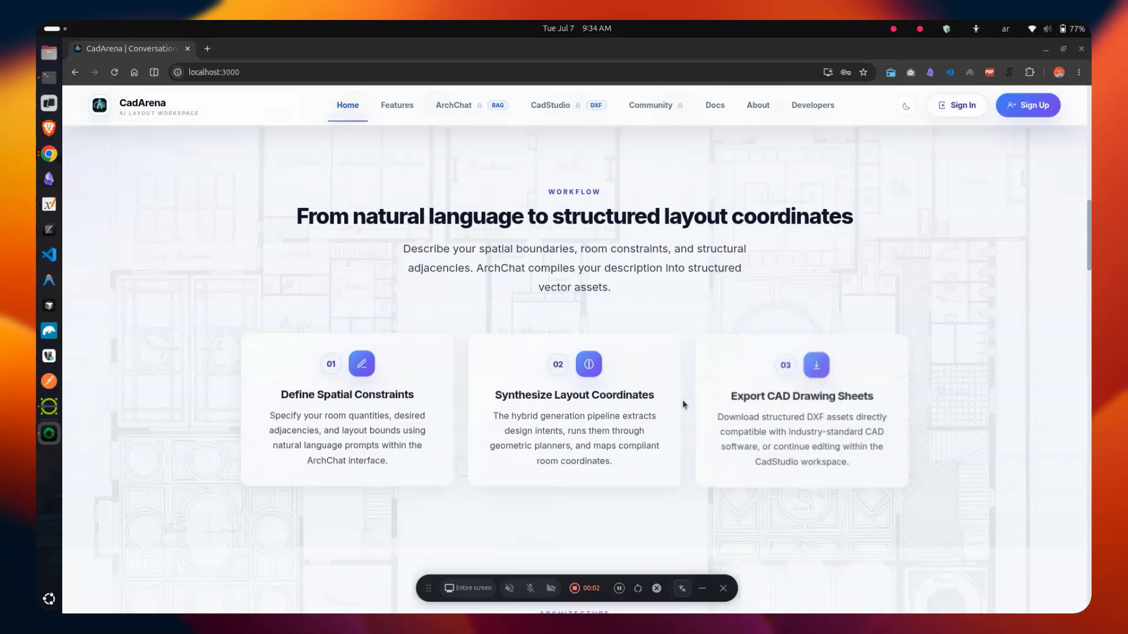

Slide 54

Thank You! (ألف شكر لحضراتكم)
Department of Artificial Intelligence and Data Science
Youssef Taha • Maher Ibrahim • Omnia Ayman • Samar Nashaat
cadarena.ai@gmail.com
Github: github.com/Youssefx64/CadArena
We welcome any questions from the honorable evaluation committee.
52
Notes:
52

